Slide 1

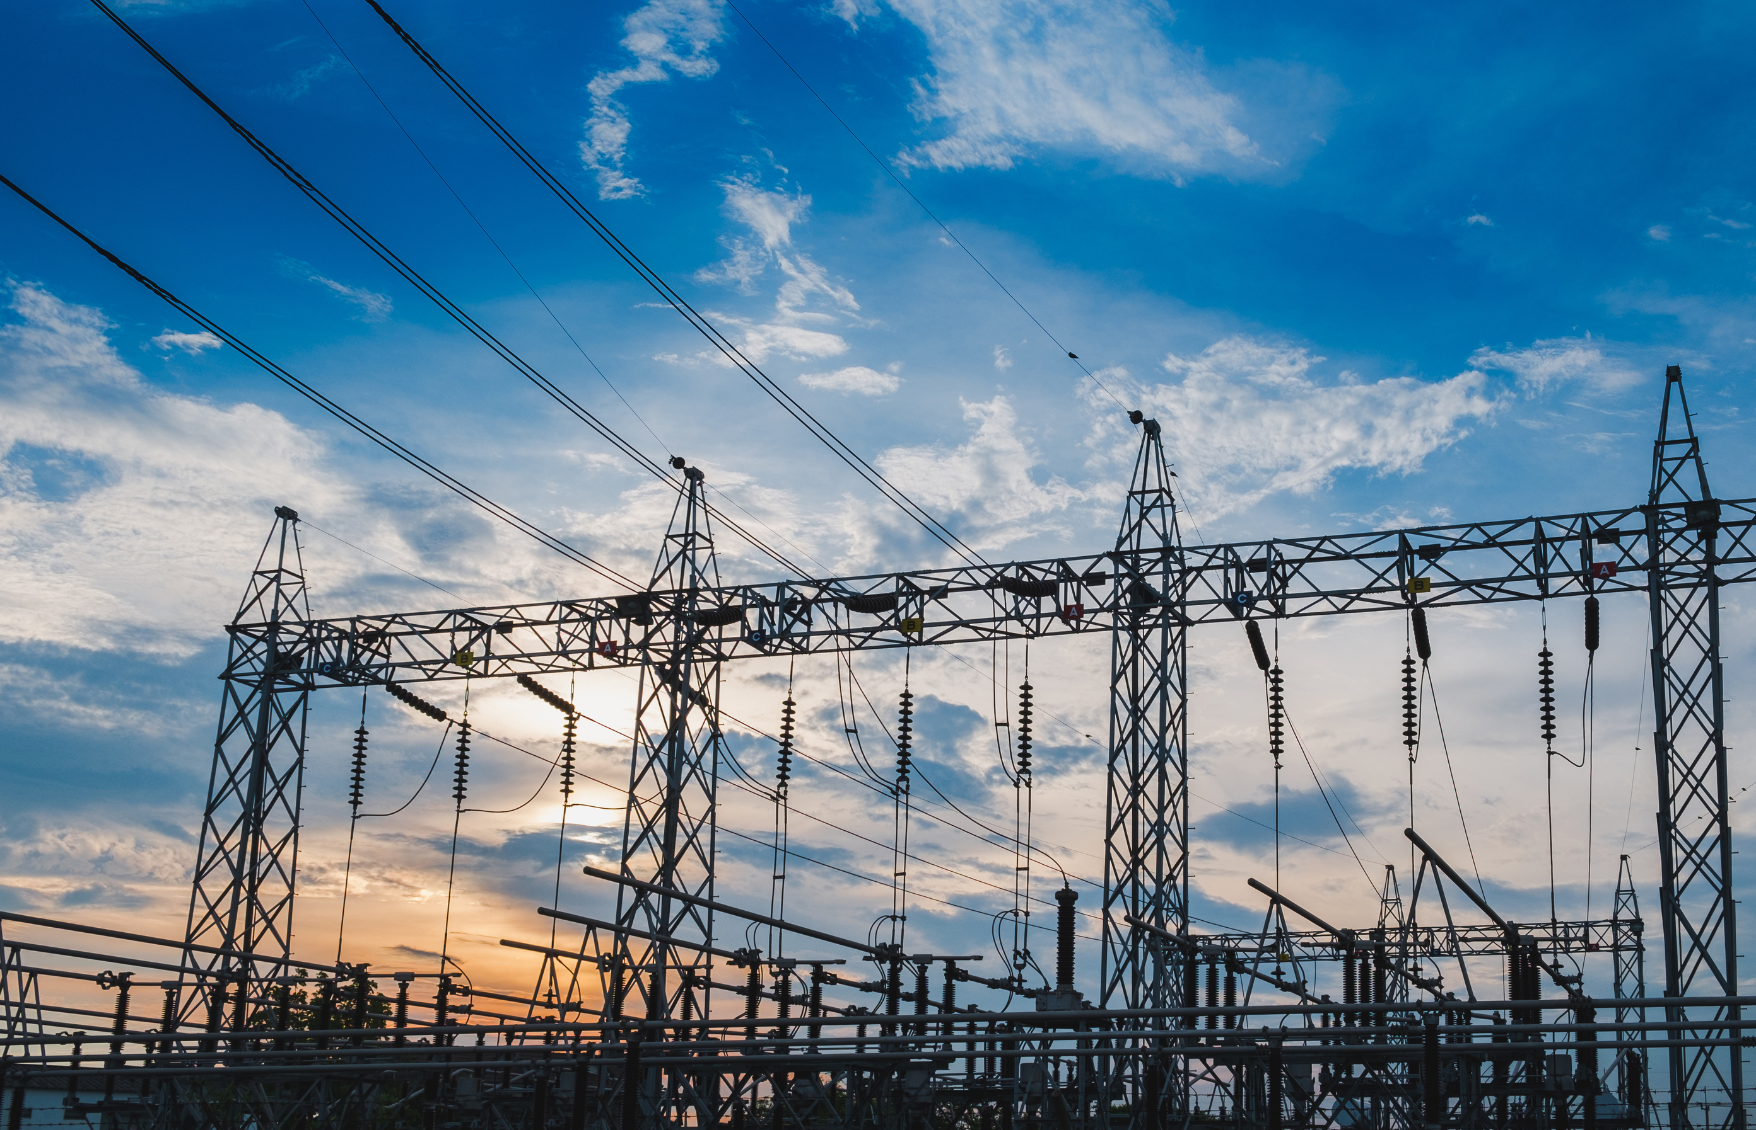

Paradoxes In Indian Power System

Slide 2
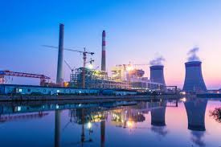
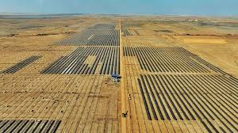
Indian Electrical Grid Scenario Present And Future
Present
  Total Installed Capacity: Crossed 500 GW.
  Non-Fossil Share: Over 51% of installed capacity (renewable, hydro, nuclear).
  Renewable Leaders: Solar (~127+ GW) and Wind (~53+ GW).
Future
  500 GW Green Target (2030): Adding 40–50 GW of solar and wind capacity annually.
  Flexible Coal: Shifting coal from pure baseload to peak-demand balancing.
  Nuclear Scale-Up (2047): Target 100 GW, integrating Small Modular Reactors (SMRs).
  Massive Storage (2032): Deploying 74 GW / 411 GWh storage (BESS + Pumped Hydro).
  Round-the-Clock RE: Moving to hybrid Solar + Wind + Battery tenders.
  Advanced Grid Corridors: Expanding ±800 kV HVDC lines for long-distance evacuation.
  Smart Grid & Meters: Rolling out 100% smart meters and AI-driven dispatching.

Slide 3

All Looking Good Then What is The Problem

Slide 4
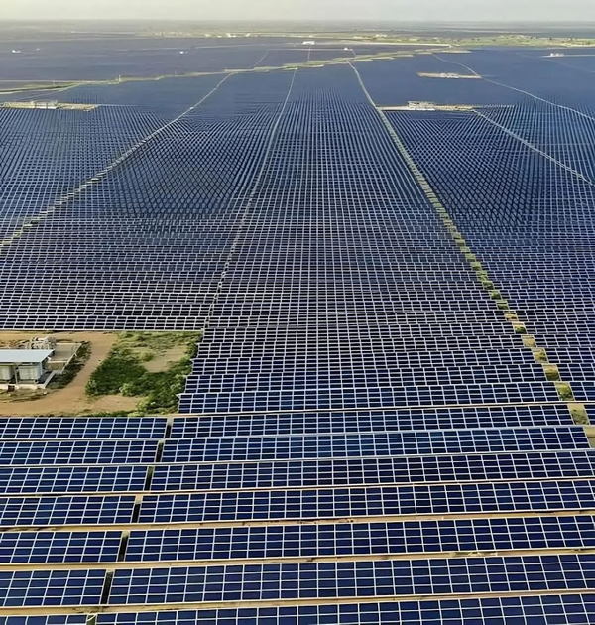
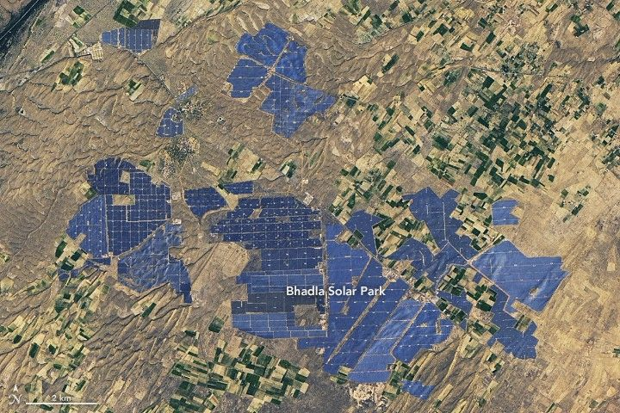
PARADOX #1: The Capacity Duplication Paradox
The Bhadla Solar Park Click to open side panel for more information in Rajasthan is one of the world's largest solar power installations.
  Total Installed Capacity: 2,245 MW (2.245 GW) of operational solar power.
  Land Area: Covers over 14,000 acres (~56 sq. km) of arid desert terrain in the Thar Desert.
  Average Daily Generation: ~12,000 to 13,500 MWh (12.0 to 13.5 GWh) per day.
  Winter / Dusty Day: ~9,000 to 10,500 MWh per day.

Slide 5
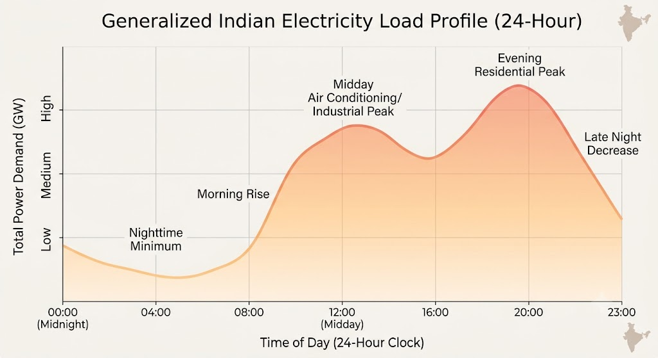

Slide 6
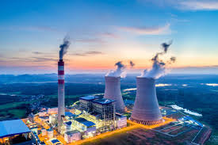
Overall Generation Share (Annual)
Out of India's total annual generation (~1,845 Billion Units / TWh):
  Thermal (Coal + Lignite + Gas): Accounts for ~70.8% of total actual electricity produced.
  Renewables + Large Hydro: Accounts for ~26.2% of total actual electricity produced.
  Nuclear: Accounts for ~3.0%.
The problem is that we still need both
SOLAR +THERMAL

Slide 7
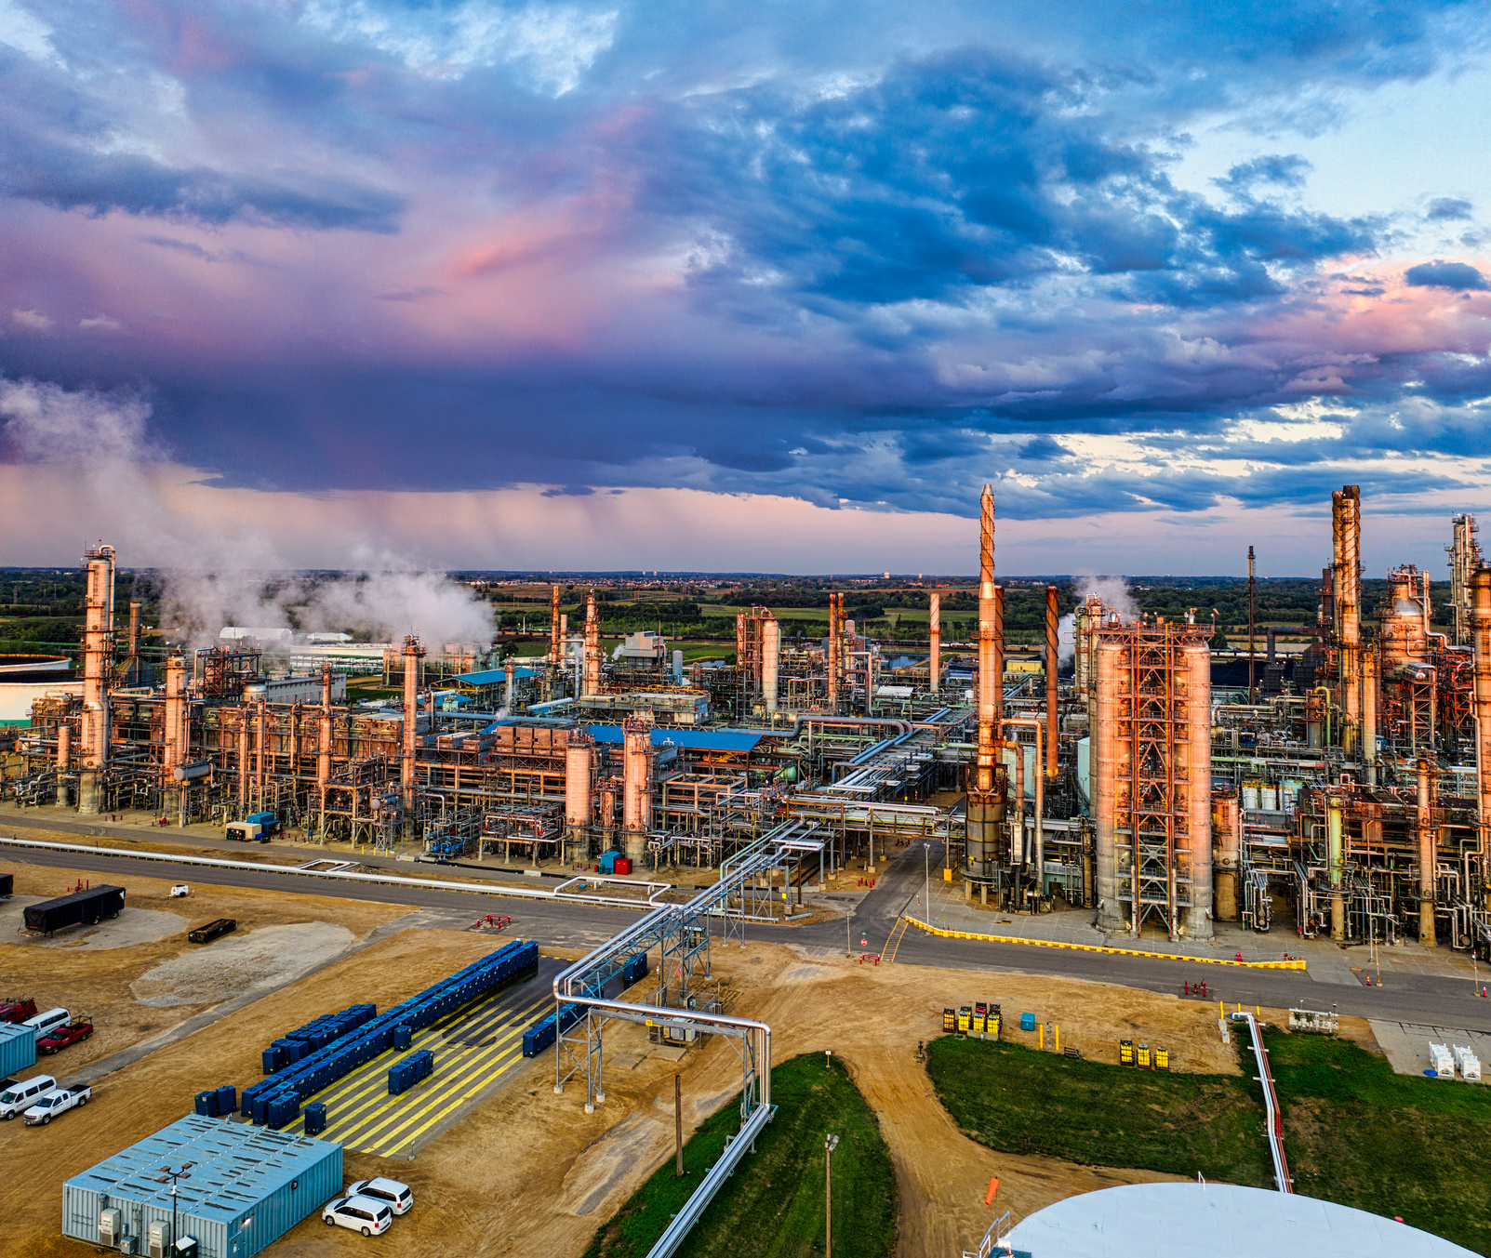
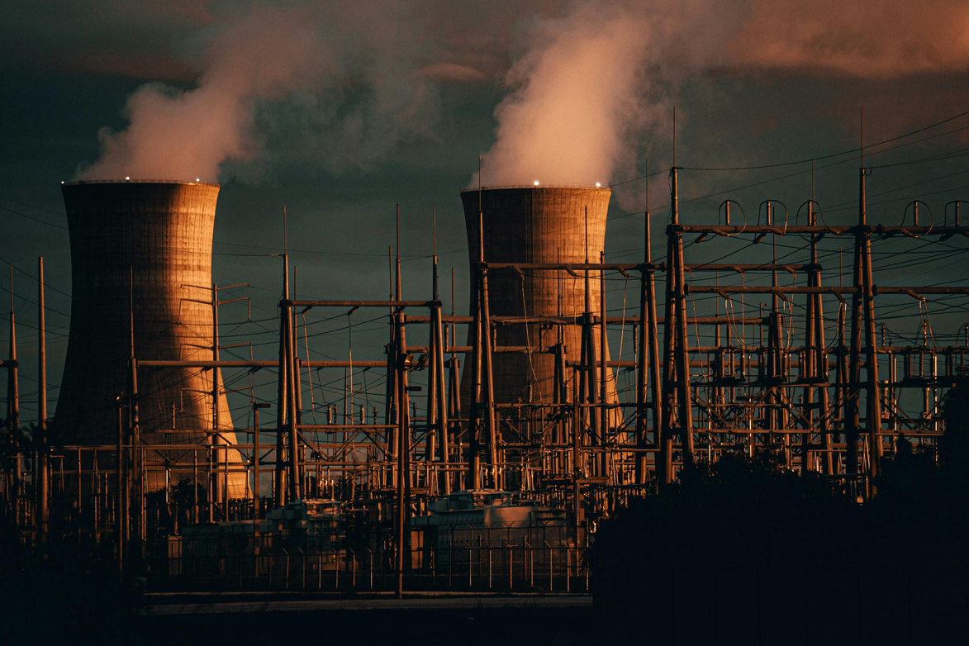
Disadvantage Of Solar + Thermal
  Dual investments keep thermal plants idling, raising fixed capacity fees on household bills.
  Time-of-Day pricing makes evening power significantly more expensive for common households.
  Dual funding wastes public tax money that could upgrade local power lines and healthcare.
  Power plants and solar washing exhaust local groundwater supplies needed for agriculture.
  Continued coal reliance maintains high air pollution and worsens local health issues.
  Expanding both solar and coal sites displaces farmers and takes away arable land.
  Frequent ramping burns coal inefficiently, adding extra fuel surcharges to bills.
  Unstable grid transitions cause voltage drops that can damage home appliances.
  Loss-making coal assets force future state tax bailouts for failing utilities.

Slide 8
PARADOX #2: The DISCOM "Death Spiral" & Cross-Subsidy Collapse
  Accumulated debt of Indian DISCOMs stands at ₹7.26 lakh crore.
  Unsustainable legacy debt disallowed for tariff recovery reached ₹2.74 lakh crore across key states.
  State-owned utilities account for the vast majority of total borrowings at ₹7.11 lakh crore.
  Accumulated losses built up over past years reached ₹7.08 lakh crore.
  Annual operating losses stood at ₹25,553 crore in FY24 before turning to a minor paper profit of ₹2,701 crore in FY25.
  Aggregate Technical & Commercial (AT&C) losses currently average 15.04% nationally.
  Tamil Nadu, Rajasthan, and Maharashtra lead state debts with over ₹90,000–1,00,000 crore each.
  The Average Cost of Supply vs. Average Revenue Realized (ACS-ARR) gap sits at ₹0.06 per unit.
  Outstanding dues owed to generation companies (GENCOs) linger around ₹4,927 crore down from peak levels.

Slide 9
Over 90% of electricity distribution is state-owned, and almost all heavy financial losses belong to government-operated DISCOMs.

Slide 10
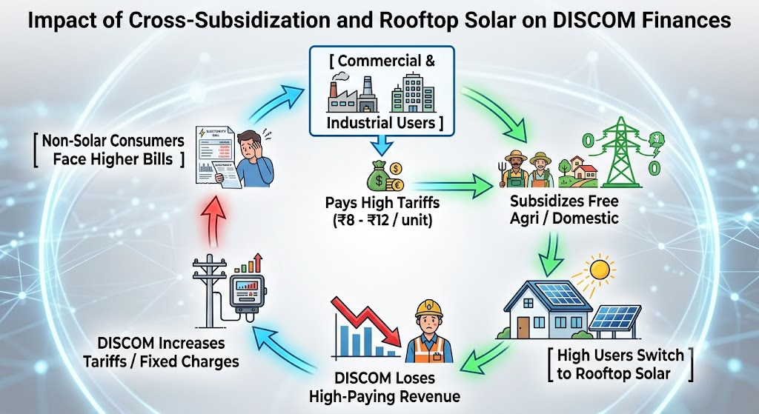

Slide 11
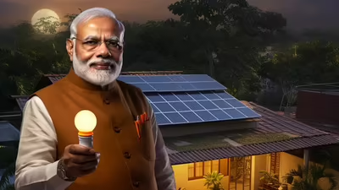
Enter Rooftop Solar (PM Surya Ghar Scheme):
When electricity costs ₹10/unit for a commercial building or upper-middle-class home, installing Rooftop Solar delivers an immediate payback in just 3 to 4 years.
  Government scheme providing up to 300 units of free electricity monthly to 1 crore households via rooftop solar.
  Offers direct subsidies of ₹30,000 for 1 kW, ₹60,000 for 2 kW, and up to ₹78,000 for 3 kW or larger systems.
  Pays subsidies directly into the owner's bank account via Direct Benefit Transfer after grid setup.
  Provides low-interest, collateral-free bank loans up to ₹2 lakh for systems up to 3 kW capacity.
  Uses net metering to feed extra daytime solar power to the grid and lower evening power bills.
  Requires valid home ownership, adequate roof space, and an active domestic electricity connection.

Slide 12
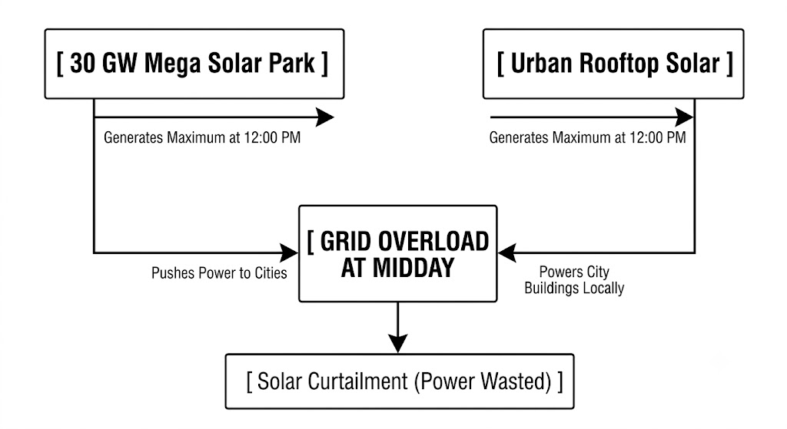
PARADOX #3: Utility-Scale Solar vs. Rooftop Solar

Slide 13
Only about 10% to 15% of solar panels sold in India are 100% made domestically from raw silicon cells up to the final module.
Roughly 80% to 85% of solar cells—the fundamental semi-conductor core that converts light into electricity—are imported (primarily from China and Southeast Asia) and then assembled locally into modules
Upstream raw materials like polysilicon, silicon ingots, and wafers have an import dependency rate of over 95%

Slide 14
Around 70% to 80% of total inverter capacity installed in Indian mega solar parks is supplied by global brands (primarily Chinese manufacturers like Sungrow, Huawei, and Sineng)
100% of the advanced semiconductors, IGBTs (Insulated Gate Bipolar Transistors), and microcontrollers inside these inverters are imported due to a lack of domestic silicon fabrication.
High-capacity utility-scale string inverters (above 250 kW to 350 kW) are almost entirely imported as finished units or knocked-down kits

Slide 15
Nearly 100% of utility-scale BESS battery cells deployed in India are imported, predominantly from China
India has 0% domestic lithium refining capacity and imports 95%+ of processed critical minerals (cathode active materials, anodes, and electrolytes)
Beyond battery cells, key power conversion equipment like PCS (Power Conversion Systems), BMS (Battery Management Systems), and high-capacity bi-directional inverters are also heavily imported

